Slide 1
SAN JOSE TRAFFIC ACCIDENTS PREDICTION
Ping Chen
Mandy Wong
Nihanjali Mallavarapu
Dhruwaksh Dave

Slide 2
Agenda
Introduction & Background
Data Collection
Data Visualization
Data Preprocessing
Algorithm & Results

Slide 3
Introduction & Background
Traffic Accidents are everywhere and happened every time all over the world. According to the statistics showing in the Association for Safe International Road Travel, nearly 1.25 million people die in road crashes each year and 20-50 million people are injured or disabled. There are so many factors to make this happen. The Bad weather conditions, for example, rain, snow, ice, and windy, etc, is one of the major factors and will be increasing the possibility of a road crash than sunny days. This project will be focusing on weather-related factors and the traffic volume to predict the possibility of traffic accidents will occur in San Jose, CA. In order to do that, we need to analyze the relationship between
weather conditions and the number of car accidents.
traffic volume and the number of car accidents.
We need to find out the common causes and how the weather impact. Then, we can predict the possibility of traffic accidents occurred in different weather conditions.
Notes:
D

Slide 4
Data Collection
Data Type | Data Source | Description
Motor Vehicle Crash Data | City of San Jose DOT open GIS Data | Crash record from 2013 to 2017 including crash location, date, number of injuries, etc 13 features
Road Network Data | City of San Jose DOT open GIS Data | Road info including road name, speed limit, historical accident counts, etc. 17 features
Traffic Volume Data | City of San Jose DOT open GIS Data | Average traffic volume data in every intersection in San Jose 23 features
Weather Data | website of California Agriculture & Natural Resources | Weather record from 2000 to 2019 including record time, highest & lowest temperature, precipitation, 6 features
Notes:
So in this project, our purpose is that for a given traffic incident, we want to predict whether it will have a crash or not depending on the weather, traffic volume and road network condition.

Slide 5
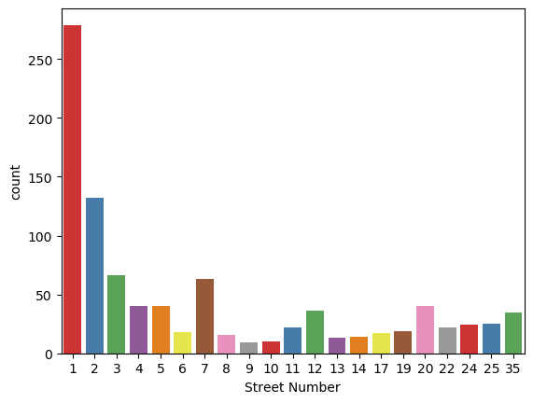
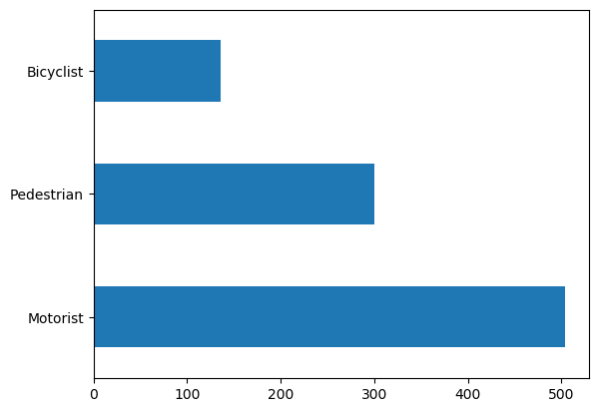
Data Visualization: Crash Data
Bar plots showing the actors involved in the crashes and the geographic locations of the crashes which have been mapped as numbers for representative purpose.
Notes:
D

Slide 6
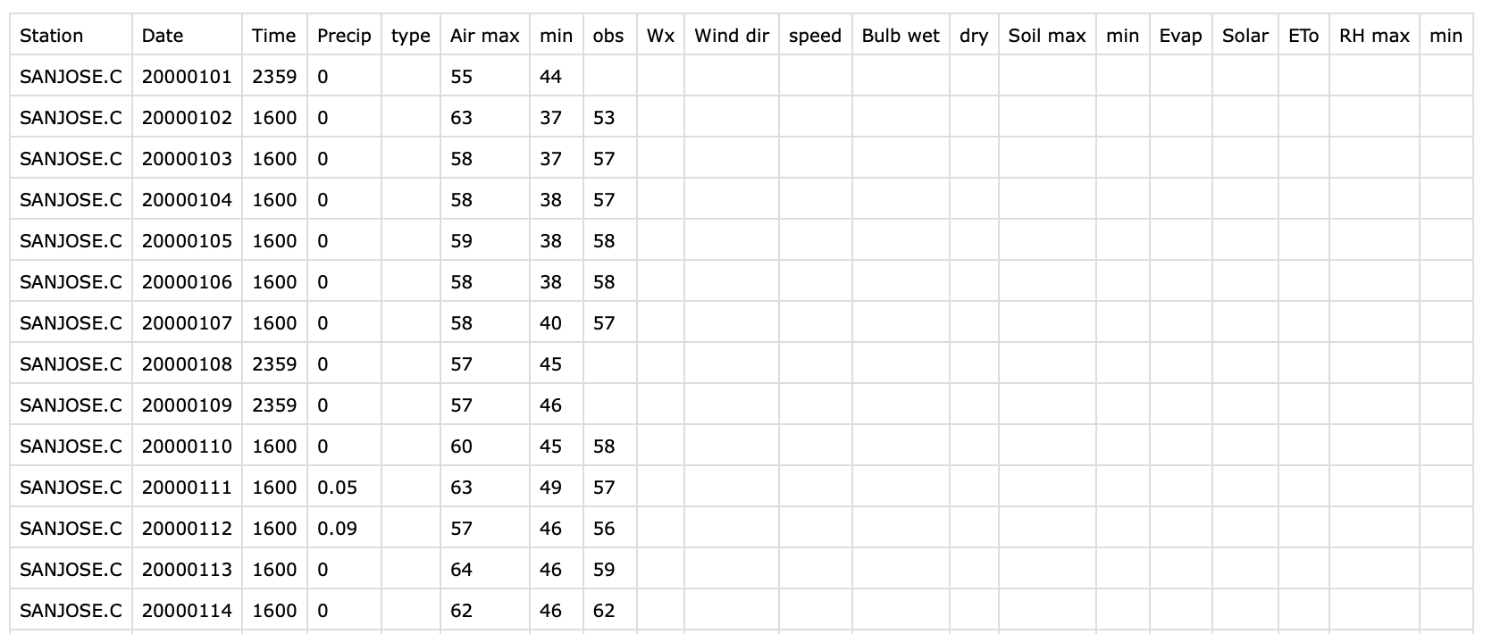
Data Preprocessing:
Data Cleaning - Weather Data (from Jan 2000 to Oct 2019)
Delete the columns that all cells are null
Use the avg. of high temp and low temp to fill in obs temp.
Notes:
Weather data were download from the website of California Agriculture & Natural Resources
Weather record are from Jan 2000 to Oct 2019 , the weather data includes the record date,record time, the highest temp, the lowest temperature, precipitation and more features, but some of the columns are empty.
First of all, we have deleted the useless columns which all cells are null
And then, we handle missing values in observed temperature columns….

Slide 7
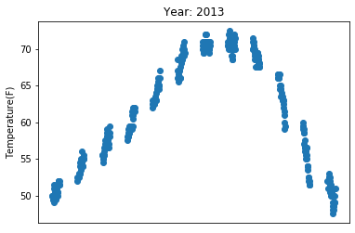


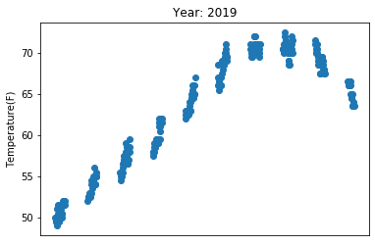



Data Visualization: Weather Data
Scatter plots show the pattern of the temperature all over the year:
Notes:
Now the weather data is cleaned, we would like to see if there is any weather pattern. According to the Scatter plots showing above, we noticed that there is an obvious pattern, we can use this pattern to predict the temperature which can help us to analyze what temperature will have a higher chance of traffic accidents happened.

Slide 8
Data Preprocessing:
Handle Missing Data:
- Latitude and Longitude: google map geocode API to find the latitude and longitude for each location
- traffic volume: fill in with the value of nearest intersection
- F85th speed value: fill in with 1.1 times of corresponding speed limit.
- Others fill in with mean values
Notes:
In the dataset we found, the location of traffic is represented by intersection names. So we want to change the location into numerical data.
9 missing values of traffic accident record,

Slide 9
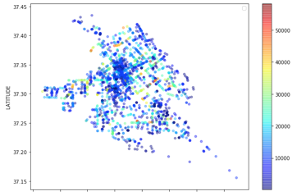
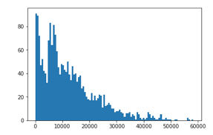
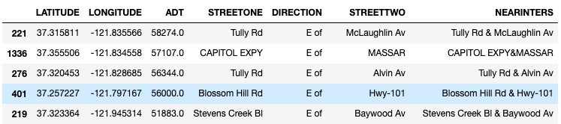
Data Visualization: Traffic Volume Data
A geographical scatter plot of average traffic volume:
Histogram:
max: 58274
min: 100
average: 12365
Check the veracity:
Notes:
This is the data visualization of traffic volume data. Create a scatter plot to visualize traffic volume with geographical information. The pattern looks exactly like San Jose. I used a color map which ranges from blue (low values) to red(high values). The high-density areas are approximately around downtown, which has a lot of intersections. The pointers with red color are located on the main road or near the highway entrance.
A histogram shows the number of instances that have a traffic volume at given value range. The max traffic volumes is 58274.0 and min value is 100, average value is 12365.
here see the top 5 items. It is reasonable that the main road like Tully RD, Capitol Express and Blossom Hill RD have the highest daily traffic volume.

Slide 10
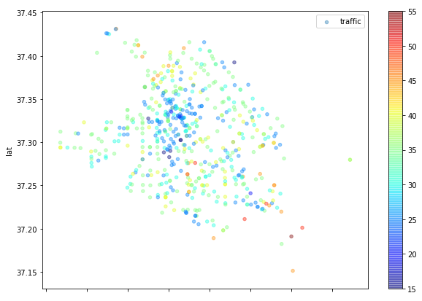
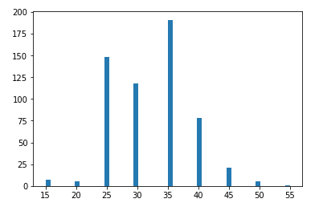
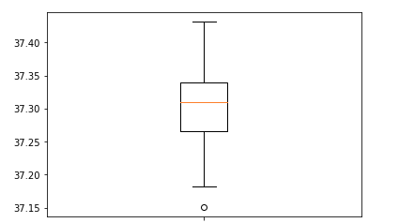
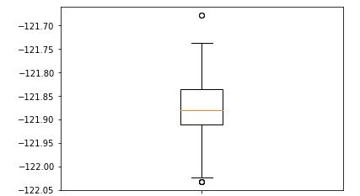
Data Visualization: Road Network Data
A geographical scatter plot of speed limit:
Histogram:
Latitude box plot
Longitude box plot
Notes:
This is the data visualization of speed limit in road network data. Since all the data we collected is about local and express road, the speed limit ranges from 15 to 55. We also build boxplot for latitude and longitude to check the veracity. There is one outlier for latitude and 6 outliers for longitude. I have checked that the corresponding items located in the boundaries of San Jose and the latitude and longitude values are correct.

Slide 11
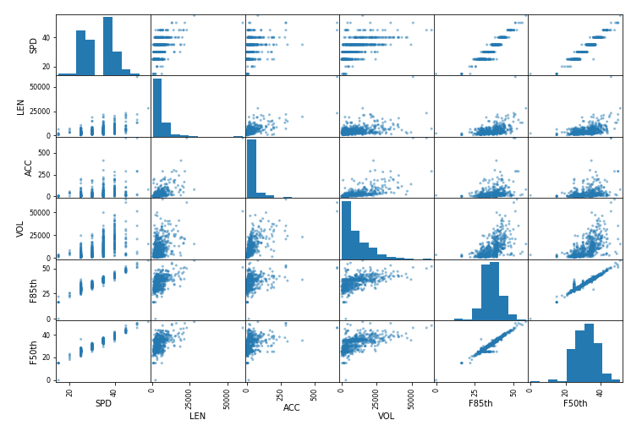
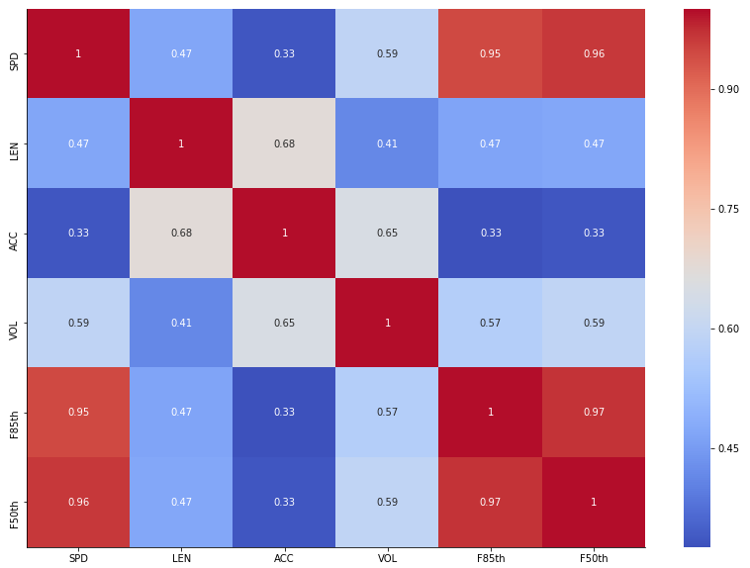
Data Visualization: Road Network Data
Correlation Matrix
Correlation Heatmap
Notes:
In road network data, we created a correlation matrix and a correlation heatmap about the features we are interested: speed limit, the number of historical accident records, road length, average speed, 85th percentile speed. We can see that all these features have a positive correlation coefficients.

Slide 12
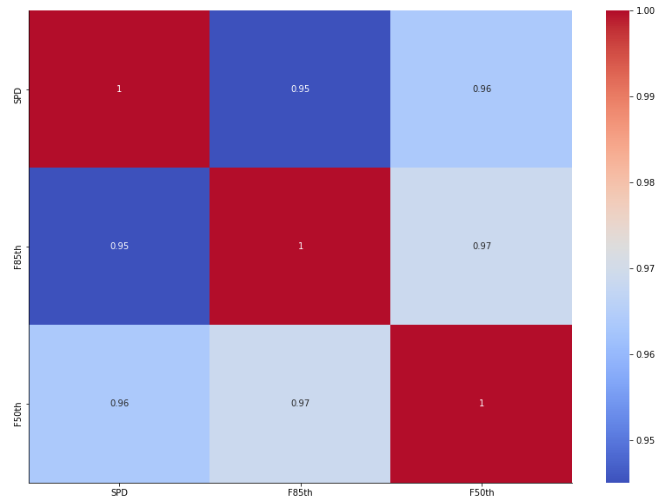
Data Preprocessing
Data Reduction
-remove irrelevant features, eg. edit person, global ID, etc
-remove redundant features, eg. speed limit, average speed and 85 percent speed, correlation coefficients are 0.96
Correlation heatmap of speed limit, average speed and 85 percent speed

Slide 13
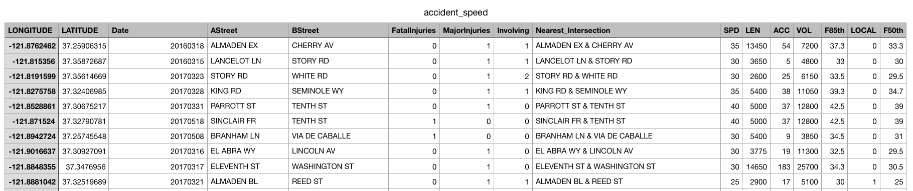
Data Preprocessing: Data Integration
Motor Vehicle Crash Data with traffic volume and road network based on location:
- Entity Identification:
eg. TULLY RD & KING RD, Tully Rd & King Rd,
KING RD & TULLY RD
- Missing value: use the nearest location instead
accident_speed.csv
Notes:
There is one problem that the intersection name in the one dataset use upper case while in the other dataset, it may have both upper case and lower case, so we change all the intersection name to upper case. Another problem is that two different names may represent the same location, like intersection name of tully rd & king rd is exactly the same location with king rd & tully rd. In order to avoide duplicated items after integration, we add columns with all the possible combinations for each item and compare all these names during integration.
Since not all the traffic incident location can find the corresponding data from other datasets,, we will use the data from the nearest intersection by computing the euclidean distance based on latitude and longitude.

Slide 14
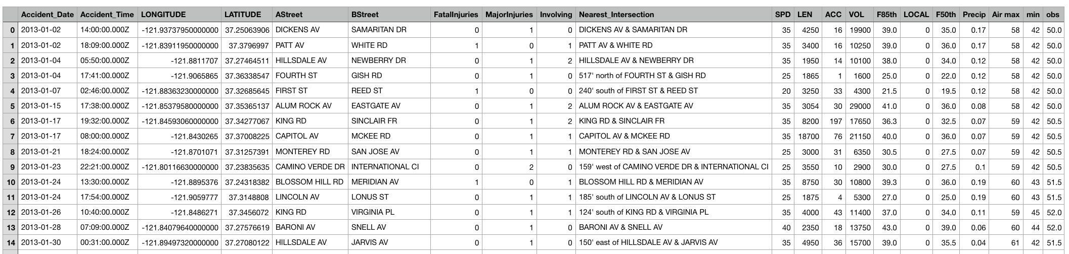
Data Preprocessing: Data Integration
After the data of Traffic volume, Road network and traffic accident have been integrated, the last step is to combine all data with the weather condition.
dataset.csv
Data has been integrated based on the accident date.
The precipitation and the temperature are mainly used from this weather dataset to be considered as factors in this prediction model to find the correlation between the weather and the possibility of traffic accidents happened.
Notes:
(Mandy) After the Traffic volume, Road network and traffic accident data have been integrated, the last step is to combine data with the weather condition.
first thing to do is reformat the date in weather data
merge 2 tables with the same date (weather_clean.csv, accident_speed.csv → dataset.csv)
we know the precipitation, highest temp, lowest temperature and observed temperature when the accidents happened

Slide 15
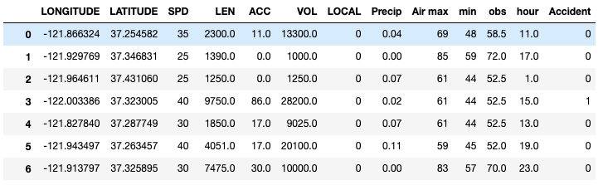
Data Preprocessing: Data Integration
Once all the dataset have been combined, we add the False Data
X: originally 21 features, we have removed some redundant columns:
We have longitude and latitude, we don’t need the street name.
remove the columns showing the number of injuries/involving
Y: Accident {1: yes; 0: no}
Finale dataset: 4352 data (852: 1, 3500: 0) with 12 features
final_data.csv
Notes:
lastly, add one more column (mark the accident = 1)
1. add false data (which accident = 0)
2. logically remove the columns that is not used for prediction, for example….

Slide 16
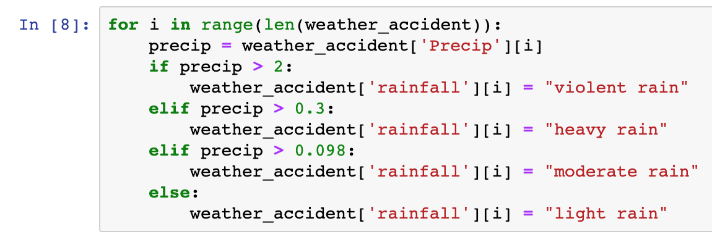
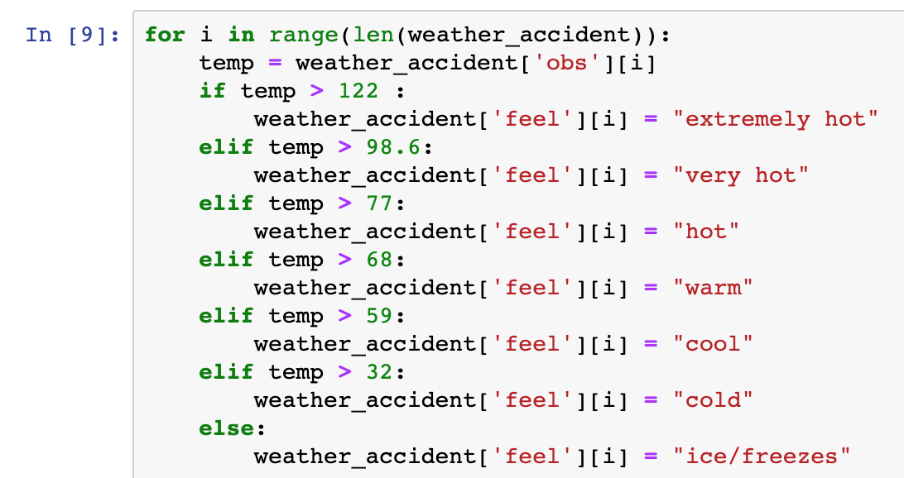
Data Visualization: Weather & Accident
Research on the definition of weather and rainfall:
Notes:
In this project, one of our goal is to find out if there is a relationship between weather condition and number of accidents, but when we look at the data, all temperature and precipitation are # and they are meaningless for the prediction. So, above is the research on the definition of the weather feel and the rainfall. We convert the temperature to corresponding weather feel like hot, warm, cool and cold and convert the precipitation to corresponding rainfall level like light rain and moderate rain.

Slide 17
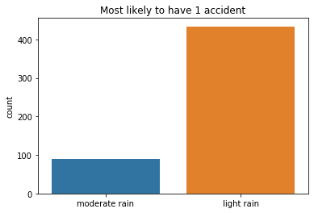
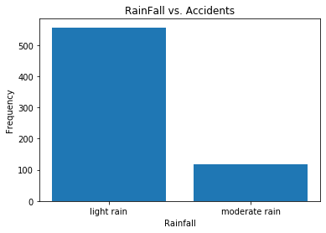
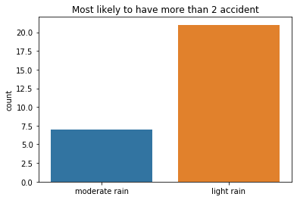
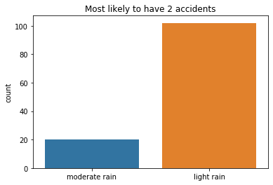
Data Visualization: Weather & Accident
Bar Plot showing the relationship between Rainfall and number of accidents:
Notes:
We found out that there is high possibility of traffic accident happen when the rainfall level is light rain. Other than light rain, moderate rain will also have possibility to induce any traffic accident than heavy rain.

Slide 18
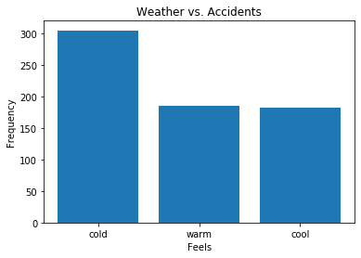
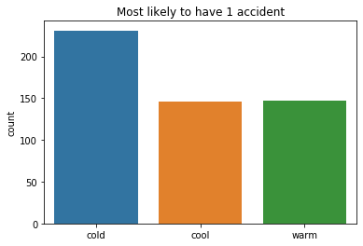
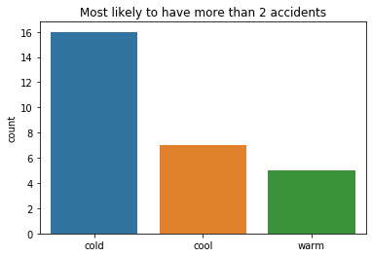
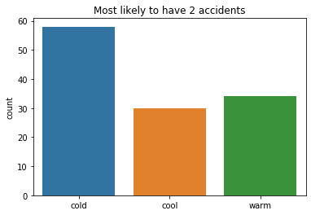
Data Visualization: Weather & Accident
Bar Plot showing the relationship between the weather and number of accidents:
Notes:
According to the graphs showing above,traffic accidents are more likely to happen when the weather is cold. Other than the cold weather, 2 traffic accidents in one day are more likely to happen when the weather is warm and more than 2 traffic accidents are more likely to happen in one day when the weather is cool.
Based on the weather pattern we analyzed before, fall and winter will possible be cool or cold weather and/or with moderate or light rain. There is shower of rain in San Jose sometimes in summer time. Those period of time will have more chance to have traffic accidents.

Slide 19
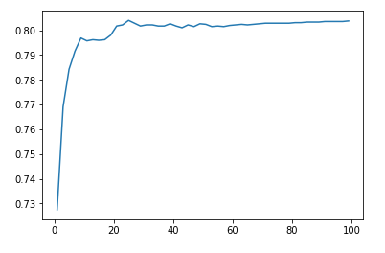
Algorithm & Results: KNN
Use 5-folds cross validation
plot the relationship between accuracy and k.
maximum k is 25 and accuracy is 80.39
Notes:
Choose default metrics (Euclidean metrics). I try different values of k in order to achieve the highest accuracy. Use 5-folds cross validation to acquire more accurate score. It can be seen from the plot that after k increasing to 25, accuracy will not increase. So in this dataset, k=25 achieve the highest accuracy, which is 80.39.

Slide 20
Algorithm & Results: SVM
Split the final_data.csv into training set and testing set with the test size=0.3
Build the Support Vector Machine with linear kernel, C= 2 and gamma = 0.01
results:
# of run | Accuracy
1 | 81.09%
2 | 78.79%
3 | 79.25%
4 | 80.02%
Notes:
Accuracy is around 80%

Slide 21
Algorithm & Results: Random Forest
-Split the training and test data into a 70-30 ratio.
-Built the model using predefined Python libraries for the implementation of Random Forests Classifier.
-Results:
Iteration | Accuracy
1 | 81.24%
2 | 81.54%
3 | 80.32%

Slide 22
Algorithm & Results: Logistic Regression
-Split the training and test data into a 70-30 ratio.
-Built the model using predefined Python libraries for the implementation of Logistic Regression
-Results:
Iteration | Accuracy
1 | 80.32%
2 | 81.06%
3 | 80.19%

Slide 23
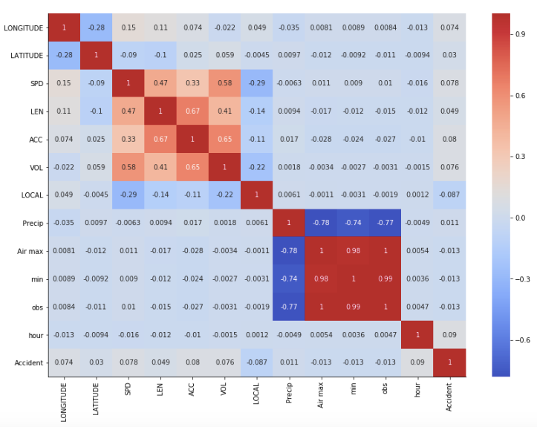
Conclusion
Traffic accidents are more likely to happen when the weather is
cold and/or
light rain.
Based on the weather pattern, fall and winter will possibly be cool or cold weather with moderate or light rain.
Traffic volume, the road
length and the speed has a strongest correlation with the
historical accident data
correlation coefficients:
(0.65, 0.67, 0.47)

Slide 24
Lessons Learnt
The most important thing we learnt during the course of the project is that human behavior is not a stable factor for prediction.
In the data, that we sourced from the San Jose PD, the physiological condition of a driver is not mentioned and that is a primary aspect when it comes to accident prediction.
For eg, a drunk or intoxicated driver is more likely to get into an accident than a sober driver. Reckless behavior is also a variable which cannot be taken for granted.
Weather is a variable to be taken into account for depression as stated by the seasonality of suicide behaviors paper- https://www.ncbi.nlm.nih.gov/pmc/articles/PMC3315262/ and that could be factor for reckless driving and suicidal behavior.

Slide 25
Project Rubric
Criteria | Ratings
Data Collection | Yes Collect 4 dataset from san jose gis data and website of California agriculture.
Variety | Yes. We use transportation data and weather data.
Visualization | Yes
Significance to the real world | Yes.
Data Reduction for quick demo | Yes. Reduce features to 11 from 4 datasets.
Veracity | Yes. We check the veracity of the data in data visualization.

Slide 26
Project Rubric
Criteria | Ratings
Code Walkthrough | Yes.
Report Format, completeness, language, plagiarism | Yes. the report wrote in IEEE format and it is completed.
Tools usage Use of the Big Data tool ecosystem | Yes. We use googlemap geocode API, github, jupyter.
Volume | Yes. We have 4352 data tuples including 12 features.
Version Control Use of Git / GitHub or equivalent | Yes. we use github. https://github.com/wmymandy/CMPE255_TrafficAccidentPrediction

Slide 27
Project Rubric
Criteria | Ratings
Lessons learnt Included in the report and presentation? | Yes. used what we have learnt in class for the data preprocessing and Machine Learning Algorithms to build and train the model.
Velocity Using streamed data in real time? | No, As we collected the data from 2013 to 2017, we were working with historical data. The model can be scaled for using real time data, with the help of tools like Kinesis or Apache Storm.
Innovation | Yes.
Evaluation of performance | Yes. The accuracy of four models archives around 80%.
Teamwork | Ping Chen: Road Network Dataset, Data Integration, KNN; Mandy Wong: climate Data,Data Integration,SVM Nihanjali Mallavarapu: Motor Vehicle Crash Data, Logistic Regression Dhruwaksh Dave: Motor Vehicle Crash Data, Random forests

Slide 28
Thank You!

